Slide 1
Introduction to
Software Testing
[Reading assignment: Chapter 1, pp. 9-22]

Slide 2
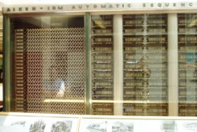
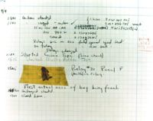
What is a computer bug?
In 1947 Harvard University was operating a room-sized computer called the Mark II.
  mechanical relays
  glowing vacuum tubes
  technicians program the computer by reconfiguring it
  Technicians had to change the occasional vacuum tube.
A moth flew into the computer and was zapped by the high voltage when it landed on a relay.
Hence, the first computer bug!
  I am not making this up :-)

Slide 3
Bugs a.k.a. …
Defect
Fault
Problem
Error
Incident
Anomaly
Variance
Failure
Inconsistency
Product Anomaly
Product Incidence
Feature :-)

Slide 4
Defective Software
We develop programs that contain defects
  How many? What kind?
Hard to predict the future, however…
it is highly likely, that the software we (including you!) will develop in the future will not be significantly better.

Slide 5
Sources of Problems
Requirements Definition: Erroneous, incomplete, inconsistent requirements.
Design: Fundamental design flaws in the software.
Implementation: Mistakes in chip fabrication, wiring, programming faults, malicious code.
Support Systems: Poor programming languages, faulty compilers and debuggers, misleading development tools.

Slide 6
Sources of Problems (Cont’d)
Inadequate Testing of Software: Incomplete testing, poor verification, mistakes in debugging.
Evolution: Sloppy redevelopment or maintenance, introduction of new flaws in attempts to fix old flaws, incremental escalation to inordinate complexity.

Slide 7
Adverse Effects of
Faulty Software
Communications: Loss or corruption of communication media, non delivery of data.
Space Applications: Lost lives, launch delays.
Defense and Warfare: Misidentification of friend or foe.

Slide 8
Adverse Effects of Faulty Software (Cont’d)
Transportation: Deaths, delays, sudden acceleration, inability to brake.
Safety-critical Applications: Death, injuries.
Electric Power: Death, injuries, power outages, long-term health hazards (radiation).

Slide 9
Adverse Effects of Faulty Software (Cont’d)
Money Management: Fraud, violation of privacy, shutdown of stock exchanges and banks, negative interest rates.
Control of Elections: Wrong results (intentional or non-intentional).
Control of Jails: Technology-aided escape attempts and successes, accidental release of inmates, failures in software controlled locks.
Law Enforcement: False arrests and imprisonments.

Slide 10
Bug in Space Code
Project Mercury’s FORTRAN code had the following fault: DO I=1.10 instead of ... DO I=1,10
The fault was discovered in an analysis of why the software did not seem to generate results that were sufficiently accurate.
The erroneous 1.10 would cause the loop to be executed exactly once!

Slide 11
Military Aviation Problems
An F-18 crashed because of a missing exception condition: if ... then ... without the else clause that was thought could not possibly arise.
In simulation, an F-16 program bug caused the virtual plane to flip over whenever it crossed the equator, as a result of a missing minus sign to indicate south latitude.

Slide 12
Year Ambiguities
In 1992, Mary Bandar received an invitation to attend a kindergarten in Winona, Minnesota, along with others born in '88.
Mary was 104 years old at the time.

Slide 13
Year Ambiguities (Cont’d)
Mr. Blodgett’s auto insurance rate tripled when he turned 101.
He was the computer program’s first driver over 100, and his age was interpreted as 1.
This is a double blunder because the program’s definition of a teenager is someone under 20!

Slide 14
Dates, Times, and Integers
The number 32,768 = has caused all sorts of grief from the overflowing of 16-bit words.
A Washington D.C. hospital computer system collapsed on September 19, 1989, days after January 1, 1900, forcing a lengthy period of manual operation.

Slide 15
Dates, Times, and Integers (Cont’d)
COBOL uses a two-character date field …
The Linux term program, which allows simultaneous multiple sessions over a single modem dialup connection, died word wide on October 26, 1993.
The cause was the overflow of an int variable that should have been defined as an unsigned int.

Slide 16
Shaky Math
In the US, five nuclear power plants were shut down in 1979 because of a program fault in a simulation program used to design nuclear reactor to withstand earthquakes.
This program fault was, unfortunately, discovered after the power plants were built!

Slide 17
Shaky Math (Cont’d)
Apparently, the arithmetic sum of a set of numbers was taken, instead of the sum of the absolute values.
The five reactors would probably not have survived an earthquake that was as strong as the strongest earthquake ever recorded in the area.

Slide 18
Therac-25 Radiation “Therapy”
In Texas, 1986, a man received between 16,500-25,000 rads in less than 1 sec, over an area of about 1 cm.
He lost his left arm, and died of complications 5 months later.
In Texas, 1986, a man received at least 4,000 rads in the right temporal lobe of his brain.
The patient eventually died as a result of the overdose.

Slide 19
Therac-25 Radiation “Therapy” (Cont’d)
In Washington, 1987, a patient received 8,000-10,000 rads instead of the prescribed 86 rads.
The patient died of complications of the radiation overdose.

Slide 20
AT&T Bug: Hello? ... Hello?
In mid-December 1989, AT&T installed new software in 114 electronic switching systems.
On January 15, 1990, 5 million calls were blocked during a 9 hour period nationwide.

Slide 21
AT&T Bug (Cont’d)
The bug was traced to a C program that contained a break statement within an switch clause nested within a loop.
The switch clause was part of a loop. Initially, the loop contained only if clauses with break statements to exit the loop.
When the control logic became complicated, a switch clause was added to improve the readability of the code ...

Slide 22
Bank Generosity
A Norwegian bank ATM consistently dispersed 10 times the amount required.
Many people joyously joined the queues as the word spread.

Slide 23
Bank Generosity (Cont’d)
A software flaw caused a UK bank to duplicate every transfer payment request for half an hour. The bank lost 2 billion British pounds!
The bank eventually recovered the funds but lost half a million pounds in potential interest.

Slide 24
Making Rupee!
An Australian man purchased $104,500 worth of Sri Lankan Rupees.
The next day he sold the Rupees to another bank for $440,258.
The first bank’s software had displayed a bogus exchange rate in the Rupee position!
A judge ruled that the man had acted without intended fraud and could keep the extra $335,758!

Slide 25
Bug in BoNY Software
The Bank of New York (BoNY) had a $32 billion overdraft as the result of a 16-bit integer counter that went unchecked.
BoNY was unable to process the incoming credits from security transfers, while the NY Federal Reserve automatically debited BoNY’s cash account.

Slide 26
Bug in BoNY Software (Cont’d)
BoNY had to borrow $24 billion to cover itself for 1 day until the software was fixed.
The bug cost BoNY $5 million in interest payments.

Slide 27
Discussion …
Have you heard of other software bugs?
  In the media?
  From personal experience?
Does this embarrass you as a future software engineer?

Slide 28
Specification
“if you can’t say it, you can’t do it”
You have to know what your product is before you can say if it has a bug.
A specification defines the product being created and includes:
  Functional requirements that describes the features the product will support. E.g., on a word processor
    Save, print, check spelling, change font, …
  Non-functional requirements are constraints on the product. E.g,
    Security, reliability, user friendliness, platform, …

Slide 29
A software bug occurs when at least one of these rules is true
The software does not do something that the specification says it should do.
The software does something that the specification says it should not do.
The software does something that the specification does not mention.
The software does not do something that the product specification does not mention but should.
The software is difficult to understand, hard to use, slow …

Slide 30
Most bugs are not because of mistakes in the code …
Specification (~= 55%)
Design (~= 25%)
Code (~= 15%)
Other (~= 5%)

Slide 31
Relative cost of bugs
“bugs found later cost more to fix”
Cost to fix a bug increases exponentially (10^{x})
  i.e., it increases tenfold as time increases
E.g., a bug found during specification costs $1 to fix.
… if found in design cost is $10
… if found in code cost is $100
… if found in released software cost is $1000

Slide 32
Bug Free Software
Software is in the news for the wrong reason
  Security breach, Mars Lander lost, hackers getting credit card information, etc.
Why can’t software engineers develop software that just works?
  As software gets more features and supports more platforms it becomes increasingly difficult to make it create bug-free.

Slide 33
Discussion …
Do you think bug free software is unattainable?
  Are their technical barriers that make this impossible?
  Is it just a question of time before we can do this?
  Are we missing technology or processes?

Slide 34
Goal of a software tester
… to find bugs
… as early in the software development processes as possible
… and make sure they get fixed.
Advice: Be careful not to get get caught in the dangerous spiral of unattainable perfection.

Slide 35
What to look for when interviewing someone for the position of software tester
Are they explorers?
Are they troubleshooters?
Are they relentless?
Are they creative?
Are they perfectionists (within reason)?
Do they exercise good judgment?
Are they tactful and diplomatic?
Are they persuasive?

Slide 36
You now know …
… what is a bug
… the relationship between specification and bugs
… the cost of a bug relative to when it is found
… the unattainable goal of perfect software
… the goal of the software tester
… valuable attributes of a software tester

Slide 37
The Software
Development Process
[Reading assignment: Chapter 2, pp. 23-36]

Slide 38
Software is …
requirements specification documents
design documents
source code
test suites and test plans
interfaces to hardware and software operating environment
internal and external documentation
executable programs and their persistent data

Slide 39
Software effort
Specification
Product reviews
Design
Scheduling
Feedback
Competitive information acquisition
Test planning
Customer surveying
Usability data gathering
Look and feel specification
Software architecture
Programming
…

Slide 40
Discussion …
What is software engineering?
Where does testing occur in the software development process?

Slide 41
Customer requirements
The software development team must determine what the customer wants.
How can you do this?
  Guess?
  Collect detailed information from surveys?
  Get feedback from a previous version of the software?
  Read reviews in magazines?
  Get information about the competition?
  Other ways?
The collected data is used to guide the specification effort.

Slide 42
Specification
“If you don't know where you're going any road will take you there”
The specification takes the data from the customer requirements and other sources and defines:
  The features of the software (functional requirements).
  The constraints on these features (non-functional requirements).
Specifications can be:
  formal (e.g., aerospace industry), rigid
  informal (e.g., a .com start up), on a cocktail napkin or a whiteboard.

Slide 43
Schedules
The goals of scheduling are to know:
  What work needs to be completed?
  How much work is left to do?
  When will the work be finished?
  Who will finish each task?
  Other measurable queries.
A Gantt chart is a popular type of bar chart that illustrates a project schedule.

Slide 44
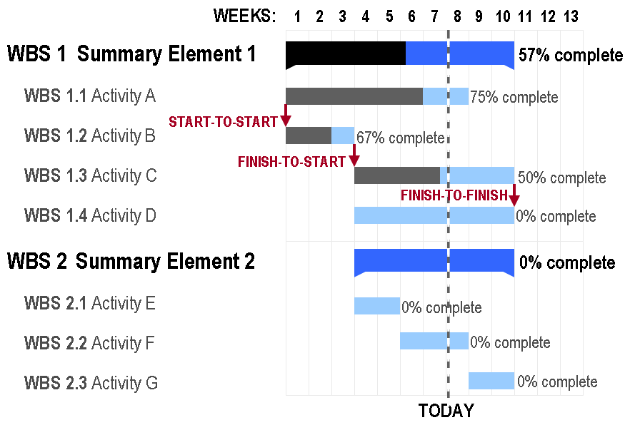
Gantt Chart

Slide 45
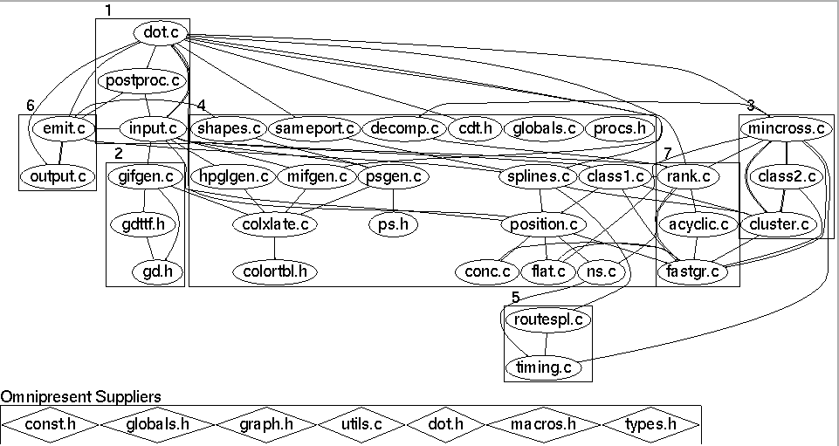
Design
Before coding begins on non-trivial software projects, a set of design documents are created to serve as blueprints.
  Software Architecture
  Data flow diagram
  State transition diagram
  Flowchart
  Commented code

Slide 46
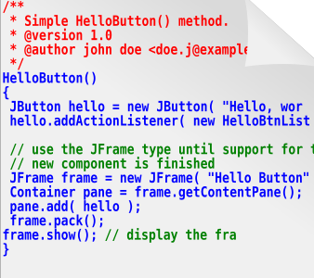
Source code … of course
The ultimate specification of the software!
‘Code is king’ philosophy is still prevalent.
Many programming languages and tools to choose from.

Slide 47
Test documents
Test plan
  Quality objectives, resource needs, schedules, assignments, methods, etc.
Test cases
  Inputs and expected outputs.
Bug reports
  E.g., the Bugzilla web-based bug tracker.
Test tools and automation
Metrics, statistics, and summaries
  Number of unresolved bugs, mean time to repair a bug, etc.

Slide 48
Software Project Staff
Project managers
  Write product specification, manage the schedule, critical decision tradeoffs
Software architects, system engineers
  Design the software, work closely with programmers
Programmers, developers, coders
  Write code, fix bugs
Testers, quality assurance staff
  Find bugs, document bugs, track progress of open bugs
Technical writers
  Write manuals, on line documentation
Configuration managers, builders
  Packaging and code, documents, and specifications

Slide 49
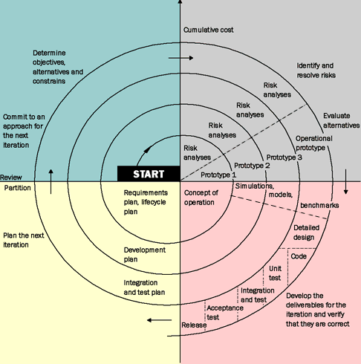
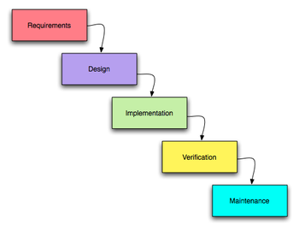
Software Development Lifecycles
Code and Fix
Waterfall
Spiral

Slide 50
You now know …
… what is software
… what is software engineering
… what is the composition of a software development organization
… what are the major phases of a software development project
… how major phased are organized

